Slide 1
Education and Engagement Evoking Community
A Consideration of Factors and Functions that Impact the Outcomes in Your Facility

Slide 2

What is Education?
1. the process of receiving or giving systematic instruction

Slide 3

AND, EDUCATION IS….
2. an enlightening experience.

Slide 4
The “FULL” Definition of Teaching
Full Definition of TEACH
transitive verb
1 a : to cause to know something <taught them a trade>
b : to cause to know how <is teaching me to drive>
c : to accustom to some action or attitude <teach students to think for themselves>
d : to cause to know the disagreeable consequences of some action <I'll teach you to come home late>
2: to guide the studies of
3: to impart the knowledge of <teach algebra>
4 a : to instruct by precept, example, or experience
b : to make known and accepted <experience teaches us our limitations>
5: to conduct instruction regularly in <teach school>

Slide 5



A good teacher can inspire hope, ignite the imagination, and instill a love of learning.
~ Brad Henry
OR?

Slide 6
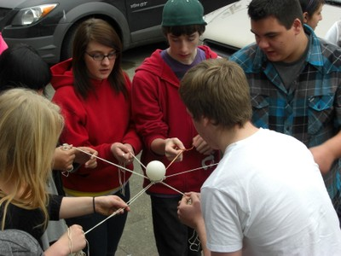
MOVING FROM EDUCTATION TO ENGAGEMENT
“Give the pupils something to do, not something to learn; and the doing is of such a nature as to demand thinking; learning naturally results.”
~ John Dewey

Slide 7
ONE WAY TO BOOST ENGAGEMENT
Discovery and ACTION Dialogues…….
Six great questions to ask (and a bonus question) to get people thinking and talking!
A new tool for you…………

Slide 8

But, we don’t have enough….
Staff
Time
Money
Talent

Slide 9

The Solution to Scarcity is
Finding the resources you already have in your community.
Remember the old story about Stone Soup?

Slide 10
In Conclusion
Did you have a new insight?
Get a new idea?
Share some knowledge or wisdom?
What do you have to add to the pot?
More asks and offers?

